Slide 1
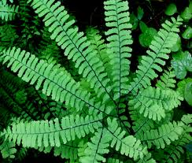
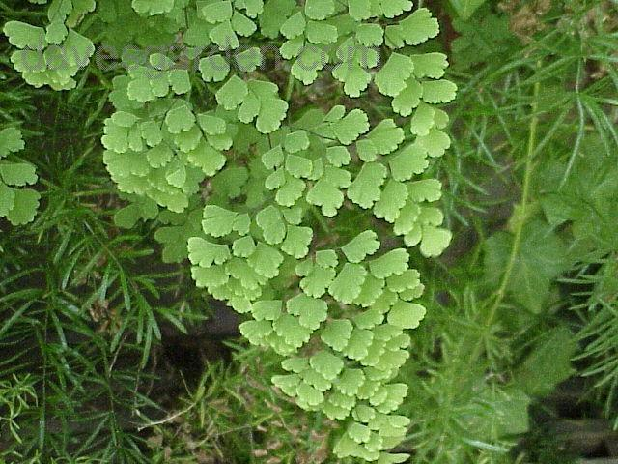
Maidenhair Fern

Slide 2
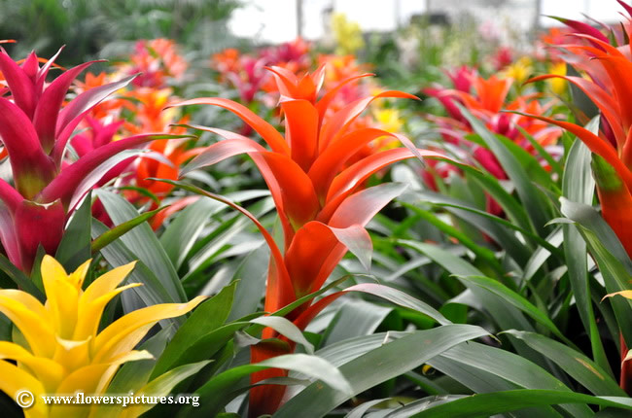
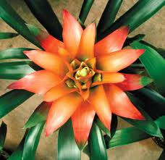
Bromeliad

Slide 3
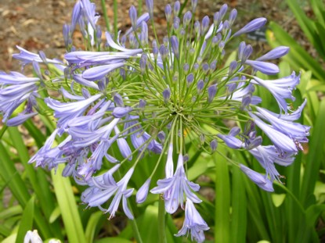
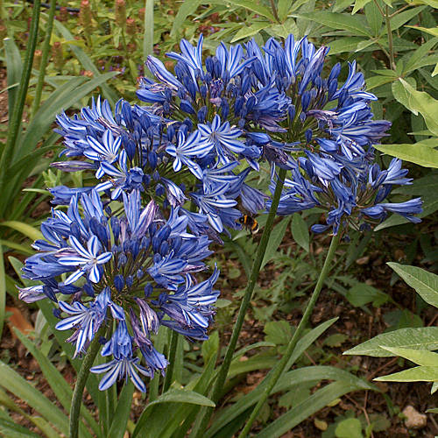
African lily

Slide 4
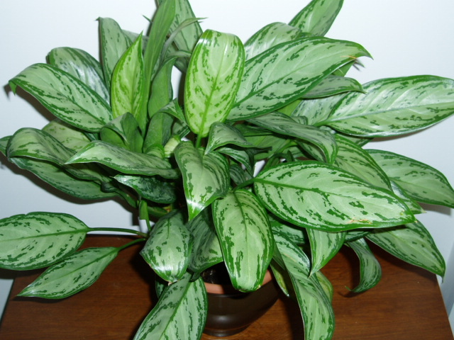
Chinese Evergreen

Slide 5
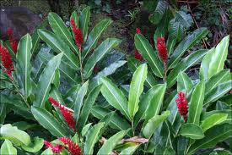
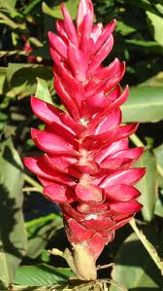
Red ginger

Slide 6
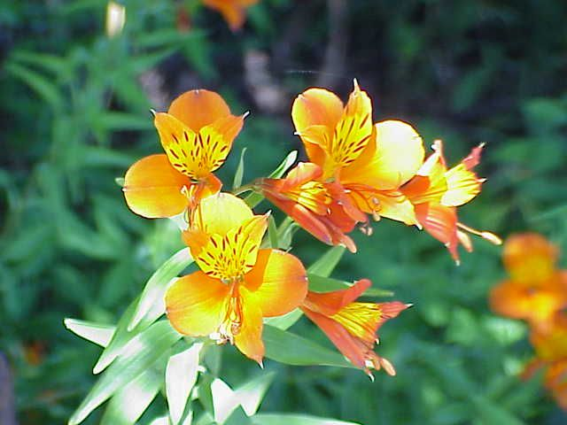
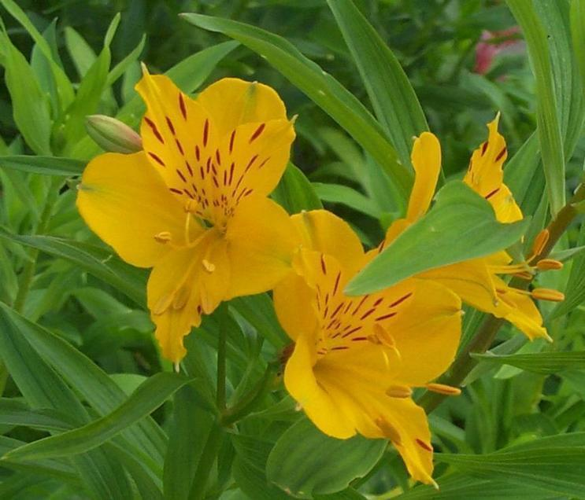
Alstroemeria, Peruvian Lily

Slide 7
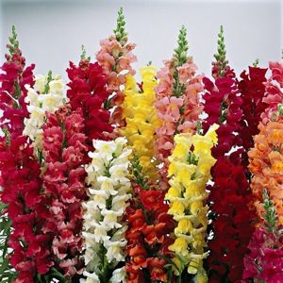
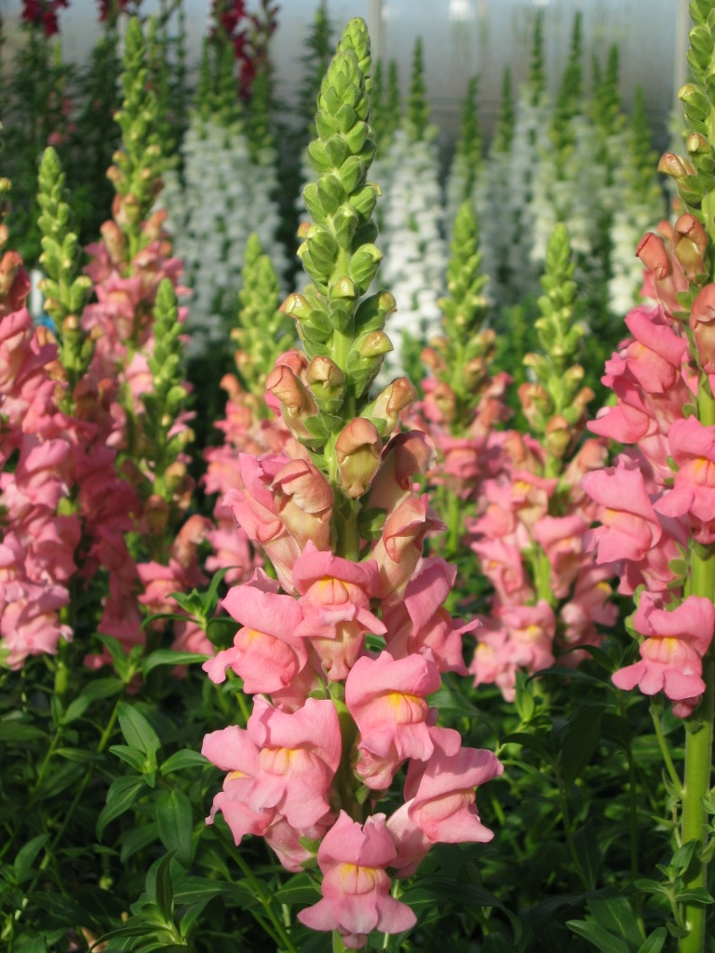
Snapdragon

Slide 8
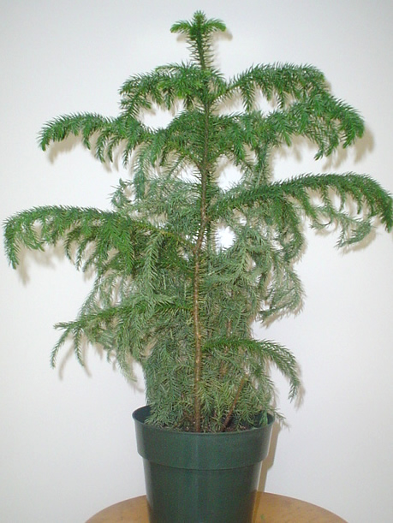
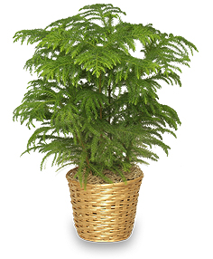
Norfolk Island Pine

Slide 9
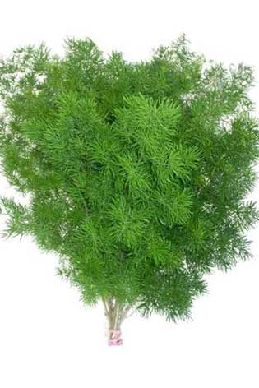
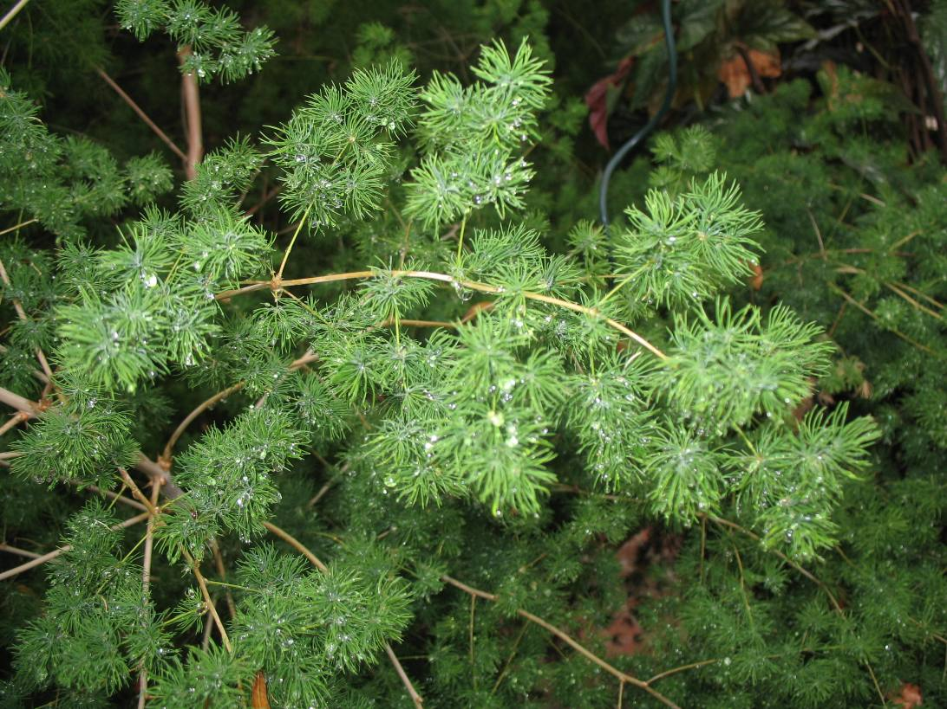
Ming Fern

Slide 10
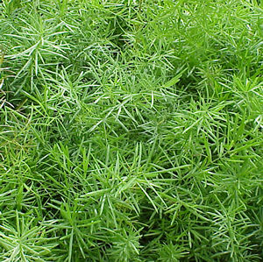
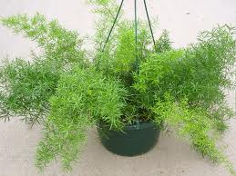
Sprengeri Fern

Slide 11
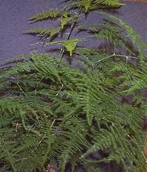
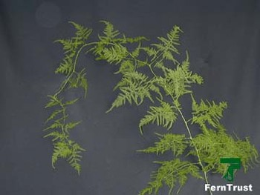
Plumosa Fern

Slide 12
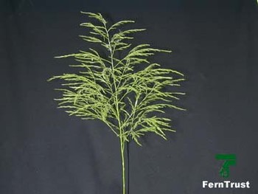
Tree Fern

Slide 13
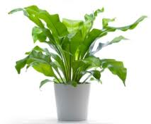
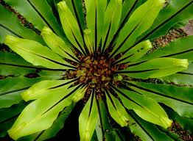
Bird’s Nest Fern

Slide 14
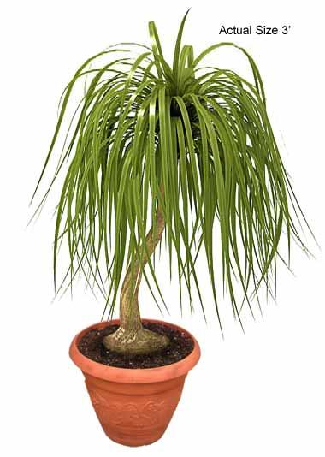
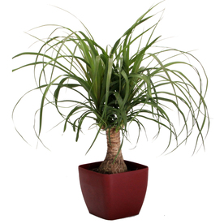
Ponytail Palm

Slide 15
Tuberous Begonia

Slide 16
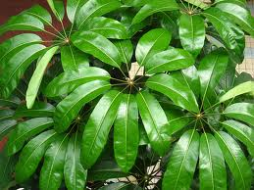
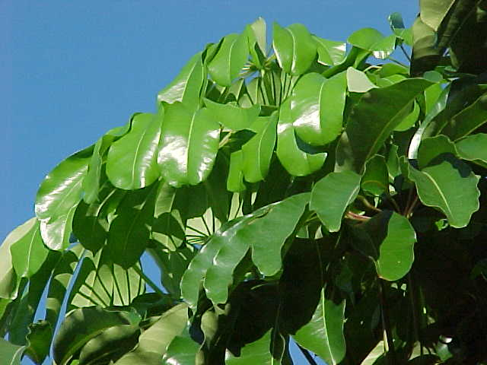
Octopus Tree

Slide 17
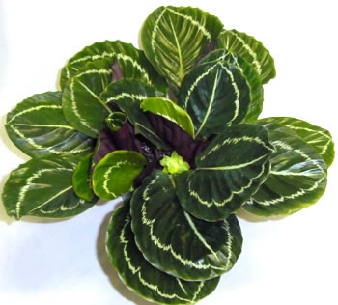
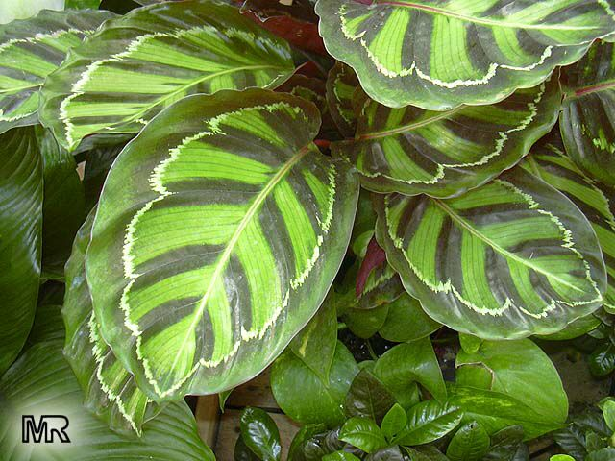
Calathea

Slide 18
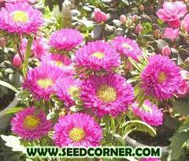
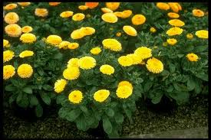
Chinese Aster

Slide 19
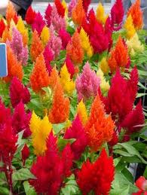
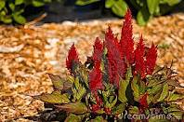
Celosia, Cockscomb

Slide 20
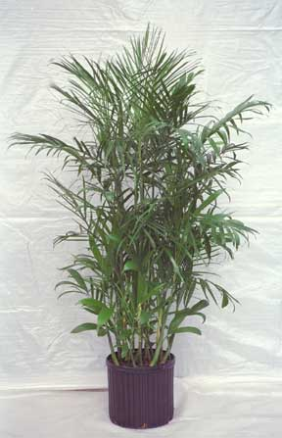
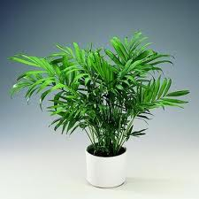
Parlor Palm, Commodore Palm

Slide 21
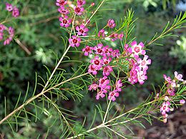
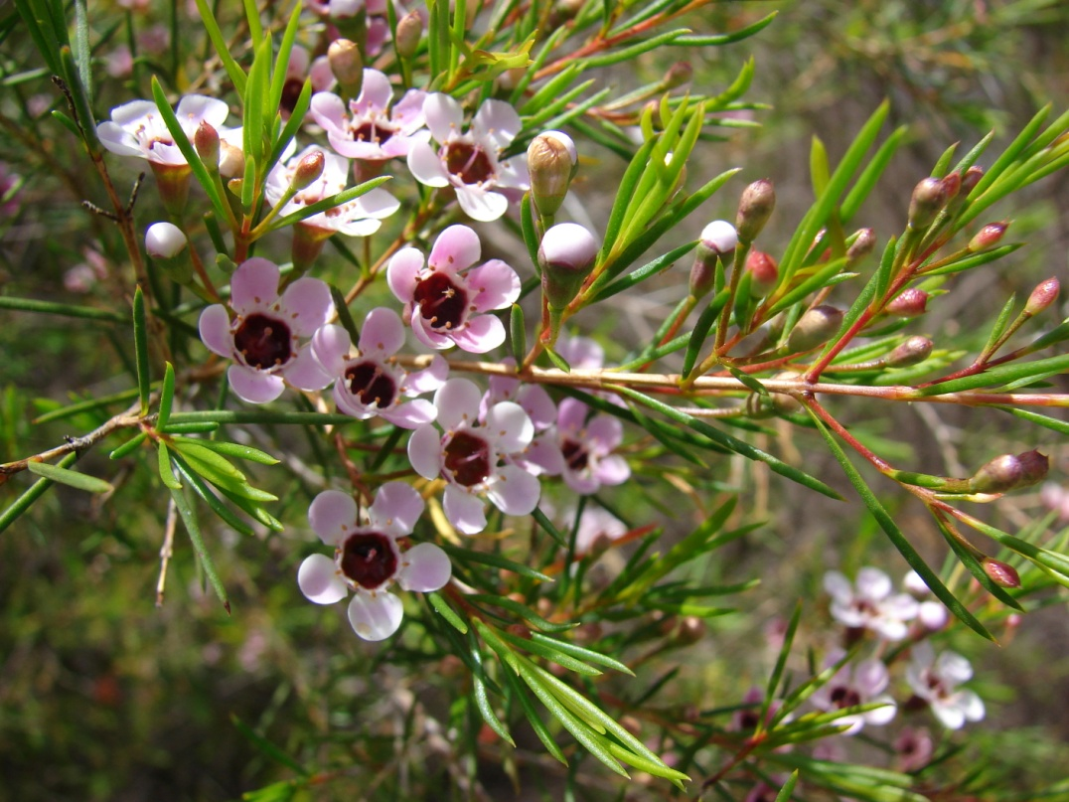
Waxflower

Slide 22
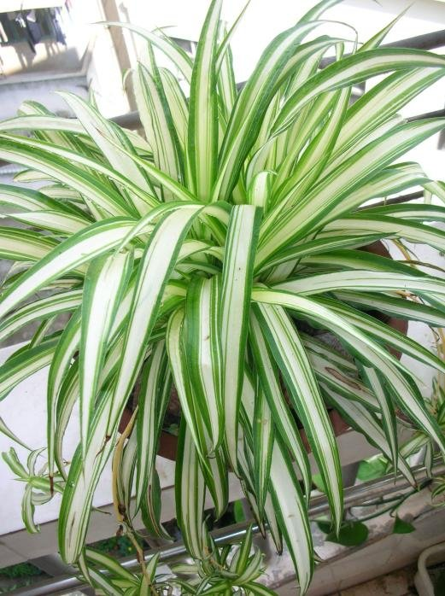
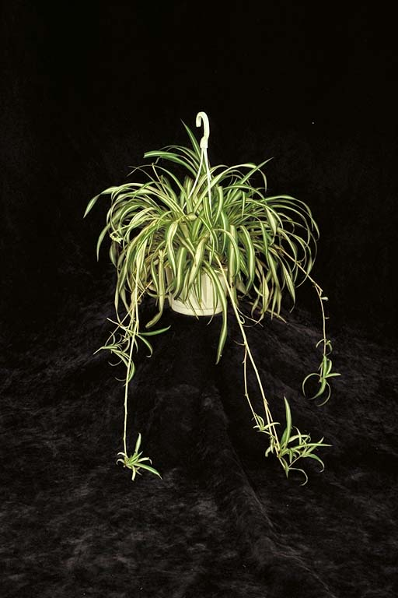
Spider Plant

Slide 23
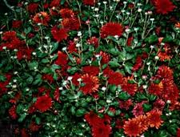
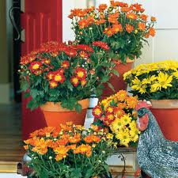
Florist’s Chrysanthemum

Slide 24
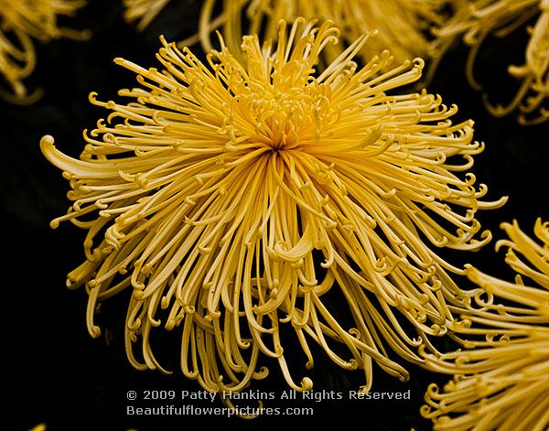
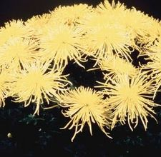
Spider Chrysanthemum

Slide 25
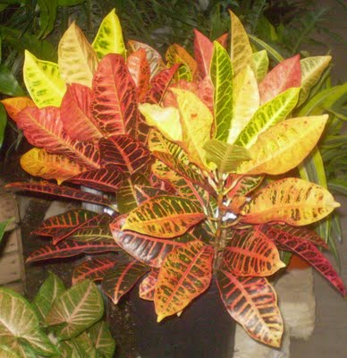
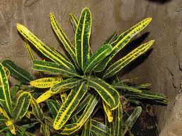
Croton

Slide 26
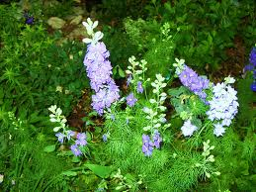
Larkspur

Slide 27
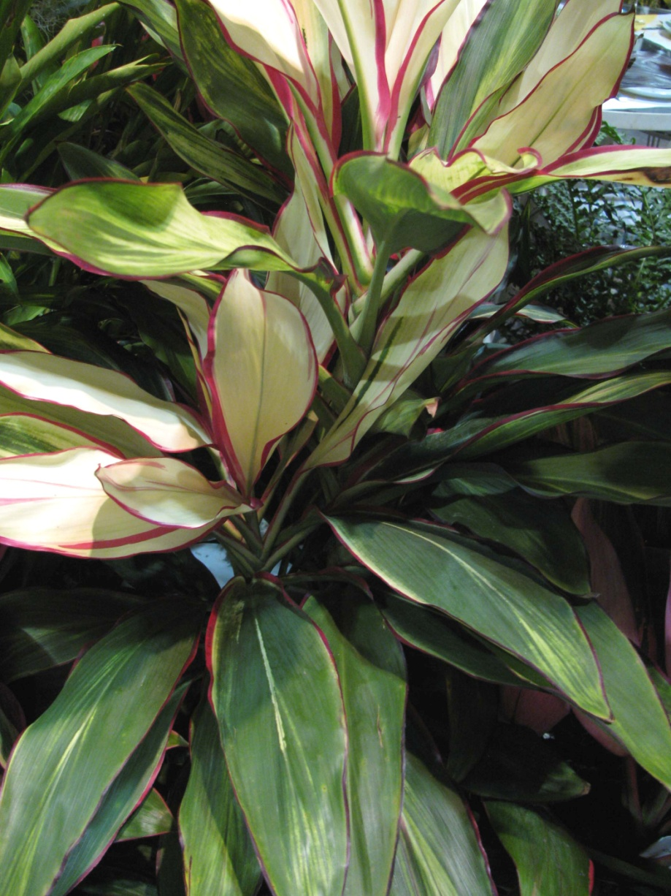
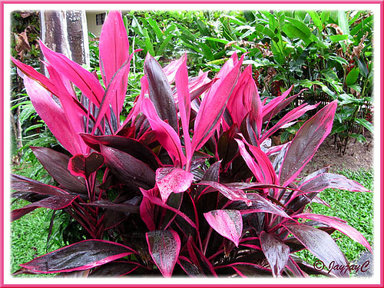
Ti Plant

Slide 28
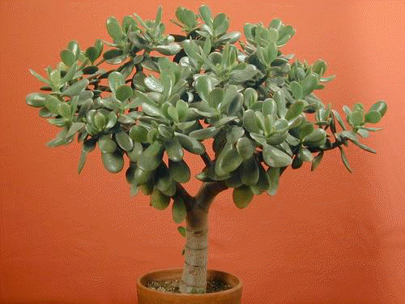
Jade Plant

Slide 29
Florist Cyclamen

Slide 30
Artichoke

Slide 31
Dahlia

Slide 32
Delphinium

Slide 33
Dendrobium Orchid

Slide 34
Florists Carnation

Slide 35
Dumbcane

Slide 36
False Aralia

Slide 37
Green Corn Plant Dracaena

Slide 38
Corn Plant Dracaena

Slide 39
Red-margined Dracaena

Slide 40
Golden Pothos

Slide 41
Spring Heather

Slide 42
Blue Thistle

Slide 43
Eucalyptus

Slide 44
Crown of Thorns

Slide 45
Poinsettia

Slide 46
Lisianthus

Slide 47
Benjamin Fig, Weeping Fig

Slide 48
Rubber Tree

Slide 49
fiddleleaf Fig

Slide 50
Forsythia

Slide 51
Freesia

Slide 52
Galax

Slide 53
Salal, Lemonleaf

Slide 54
Gerbera, Transvaal Daisy

Slide 55
Gladiolus

Slide 56
Baby’s Breath

Slide 57
English Ivy

Slide 58
Sunflower

Slide 59
Amaryllis

Slide 60
Wax Plant

Slide 61
Hyacinth

Slide 62
Hydrangea

Slide 63
Hypericum Berries

Slide 64
Iris

Slide 65
Kalanchoe

Slide 66
Liatris

Slide 67
Asiatic Lily

Slide 68
Stargazer Lily

Slide 69
Trumpet Easter Lily

Slide 70
Caspia, Misty Blue

Slide 71
Sea Lavender Statice

Slide 72
Statice

Slide 73
Prayer Plant

Slide 74
Stock

Slide 75
Bells of Ireland

Slide 76
Split-leaf Philodendron

Slide 77
Myrtle

Slide 78
Daffodil

Slide 79
Boston Fern

Slide 80
Flat Fern

Slide 81
shrimp plant

Slide 82
Peony

Slide 83
Zigzag Plant

Slide 84
Peperomia

Slide 85
Phalaenopsis, Butterfly Orchid

Slide 86
Heartleaf Philodendron

Slide 87
Mock Orange

Slide 88
Swedish Ivy

Slide 89
Turberose

Slide 90
Protea

Slide 91
Ranunculus

Slide 92
Azalea

Slide 93
Hybrid Tea Rose

Slide 94
Leatherleaf Fern

Slide 95
Italian Ruscus

Slide 96
Israeli Ruscus, Butcher’s Broom Ruscus

Slide 97
African Violet

Slide 98
Pussy Willow

Slide 99
Curly Willow

Slide 100
Sansevieria, Snake Plant

Slide 101
Thanksgiving cactus

Slide 102
Solidago, Goldenrod

Slide 103
Spathiphyllum, Peace Lily

Slide 104
Stephanotis, Bridal Wreath

Slide 105
Bird of Paradise

Slide 106
Nepthytis

Slide 107
Tulip

Slide 108
Viburnum

Slide 109
Bear Grass

Slide 110
Calla

Slide 111
Wandering Jew

